Slide 1
Chapter 3
Requirements Engineering and Principles

Slide 2
Analysis Principles
1.The information domain of a problem must be represented and understood.
2.The function that the software is to be perform must be defined.
3. The behavior of the software must be represented
4. The model that depict information, function, and behavior must be partitioned in hierarchical fashion 5. The analysis process should move from essential information toward implementation details

Slide 3
Analysis Principles
By applying these principles, the analysis principles, the analyst approaches a problem systematically .
• Information domain is examined so that the function may be understood more completely
• Models are used so that the characteristics of function and behavior can be communicated in a compact fashion.
• Partitioning is applied to reduce complexity

Slide 4
Analysis Principles
The requirements for a system are the descriptions of what the system should do, the services that it provides and the constraints on its operation.
These requirements reflect the needs of customers for a system that serves a certain purpose such as con trolling a device, placing an order, or finding information.

Slide 5
Requirement Engineering
The process of finding out, analyzing, documenting and checking these services and constraints is called requirements engineering (RE).

Slide 6
Requirement Engineering
User requirement - High level of abstraction
System requirement – Detailed description

Slide 7
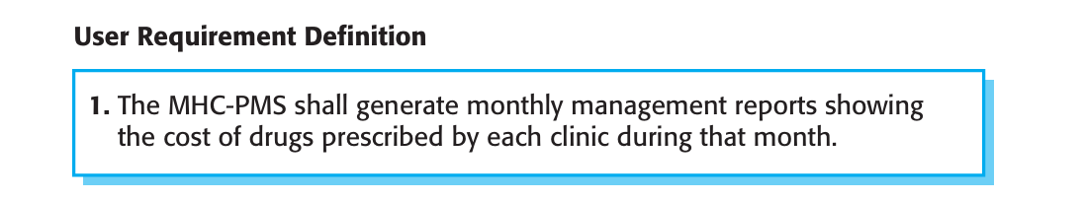

Slide 8
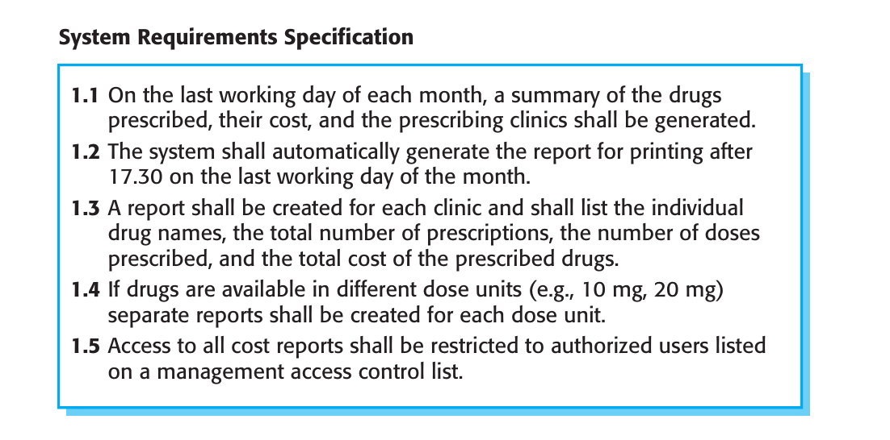

Slide 9
Functional Requirement
The functional requirements for a system describe what the system should do.
These requirements depend on the type of software being developed, the expected users of the software, and the general approach taken by the organization when writing requirements

Slide 10
Functional Requirement
When expressed as user requirements, functional requirements are usually described in an abstract way that can be understood by system users.
However, more specific functional system requirements describe the system functions, its inputs and outputs, exceptions, etc., in detail.

Slide 11
Non Functional Requirement
are requirements that are not directly concerned with the specific services delivered by the system to its users.
They may relate to emergent system properties such as reliability, response time, and store occupancy.
Alternatively, they may define constraints on the system implementation such as the capabilities of I/O devices or the data representations used in inter faces with other systems.

Slide 12
Non-functional Requirement
Non-functional requirements, such as performance, security, or availability, usually specify or constrain characteristics of the system as a whole.
Non-functional requirements are often more critical than individual functional requirements.

Slide 13
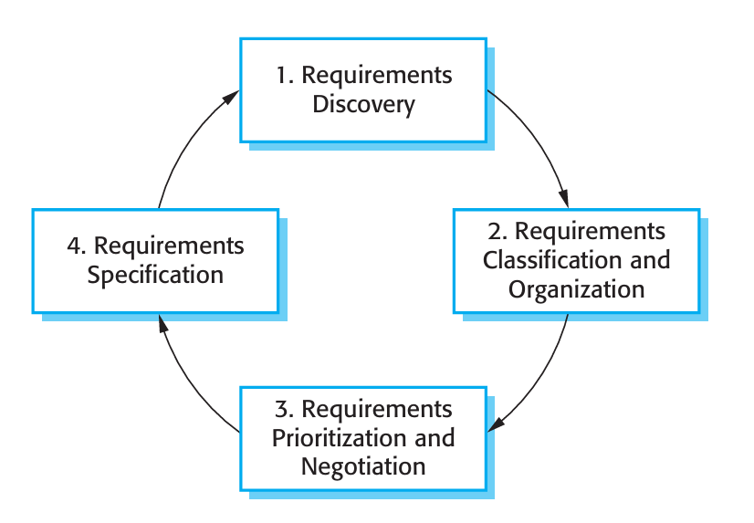
Requirements elicitation and analysis process

Slide 14
There are two fundamental approach
Interviewing
Observation or ethnography.

Slide 15
Fundamental approach
Interviewing
Observation or ethnography.
Scenarios

Slide 16
Interview
Formal or informal interviews with system stakeholders are part of most require ments engineering processes.
In these interviews, the requirements engineering team puts questions to stakeholders about the system that they currently use and the sys tem to be developed.
Requirements are derived from the answers to these questions.
Interviews may be of two types:

Slide 17
Closed interviews: where the stakeholder answers a pre-defined set of questions.
Open interviews: in which there is no pre-defined agenda. The requirements engineering team explores a range of issues with system stakeholders and hence develop a better understanding of their needs

Slide 18
Interviews
In practice, interviews with stakeholders are normally a mixture of both of these.
You may have to obtain the answer to certain questions but these usually lead on to other issues that are discussed in a less structured way.

Slide 19
Ethnography
Software systems do not exist in isolation.
They are used in a social and organizational context and software system requirements may be derived or constrained by that context.
Satisfying these social and organizational requirements is often critical for the success of the system.
One reason why many software systems are delivered but never used is that their requirements do not take proper account of how the social and organizational context affects the practical operation of the system.

Slide 20
Ethnography
Ethnography is an observational technique that can be used to understand operational processes and help derive support requirements for these processes
An analyst immerses himself or herself in the working environment where the system will be used.
The day-to-day work is observed and notes made of the actual tasks in which participants are involved.
The value of ethnography is that it helps discover implicit system requirements that reflect the actual ways that people work, rather than the formal processes defined by the organization.

Slide 21
Ethnography
People often find it very difficult to articulate details of their work because it is second nature to them.
They understand their own work but may not understand its relationship to other work in the organization.
Social and organizational factors that affect the work, but which are not obvious to individuals, may only become clear when noticed by an unbiased observer.
For example, a work group may self-organize so that members know of each other’s work and can cover for each other if someone is absent.
This may not be mentioned during an interview as the group might not see it as an integral part of their work.

Slide 22
Scenarios
People usually find it easier to relate to real-life examples rather than abstract descriptions.
They can understand and criticize a scenario of how they might interact with a software system.
Requirements engineers can use the information gained from this discussion to formulate the actual system requirements.
Scenarios can be particularly useful for adding detail to an outline requirements description.
They are descriptions of example interaction sessions.
Each scenario usually covers one or a small number of possible interactions.
Different forms of scenarios are developed and they provide different types of information at different levels of detail about the system.

Slide 23
Scenario
A scenario starts with an outline of the interaction.
During the elicitation process, details are added to this to create a complete description of that interaction.
At its most general, a scenario may include:

Slide 24
Scenario
1. A description of what the system and users expects when the scenario starts.
2. A description of the normal flow of events in the scenario.
3. A description of what can go wrong and how this is handled.
4. Information about other activities that might be going on at the same time.
5. A description of the system state when the scenario finishes

Slide 25
Requirement Specification
Use cases
Uses cases are a away of describing interactions between users and a system using a graphical model and structured text.

Slide 26
Requirements Engineering Processes
Requirements engineering processes may include four high-level activities.
These focus on assessing if the system is useful to the business (feasibility study)
discovering requirements (elicitation and analysis)
converting these requirements into some standard form (specification)
checking that the requirements actually define the system that the customer wants (validation).
Requirement engineering is an iterative process in which the activities are interleaved.

Slide 27
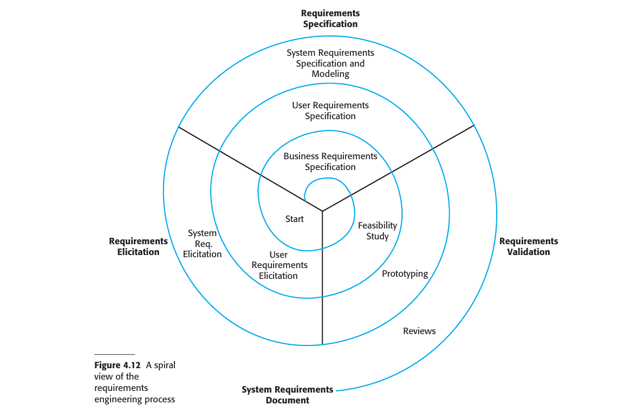
Requirements Engineering Process

Slide 28
Requirements Engineering Process
The activities are organized as an iterative process around a spiral, with the output being a system requirements document.
The amount of time and effort devoted to each activity in each iteration depends on the stage of the overall process and the type of system being developed.
Early in the process, most effort will be spent on understanding high-level business and non-functional requirements, and the user requirements for the system.

Slide 29
Requirement Engineering Process
Later in the process, in the outer rings of the spiral, more effort will be devoted to eliciting and understanding the detailed system requirements.
This spiral model accommodates approaches to development where the requirements are developed to different levels of detail.
The number of iterations around the spiral can vary so the spiral can be exited after some or all of the user requirements have been elicited.
Agile development can be used instead of prototyping so that the requirements and the system implementation are developed together.

Slide 30
Requirements Engineering Process
Some people consider requirements engineering to be the process of applying a structured analysis method, such as object-oriented analysis.
This involves analyzing the system and developing a set of graphical system models, such as use case models, which then serve as a system specification.

Slide 31
Requirement Validation
Requirements validation is the process of checking that requirements actually define the system that the customer really wants.
Requirements validation is important because errors in a requirements document can lead to extensive rework costs when these problems are discovered during development or after the system is in service.

Slide 32
Requirement Validation
During the requirements validation process, different types of checks should be carried out on the requirements in the requirements document.
These checks include
1.Validity checks: A user may think that a system is needed to perform certain func tions.
2. Consistency checks: Requirements in the document should not conflict..
3. Completeness checks: The requirements document should include requirements that define all functions and the constraints intended by the system user.

Slide 33
Requirements Engineering Process
4. Realism checks :Using knowledge of existing technology, the requirements should be checked to ensure that they can actually be implemented.
5. Verifiability: To reduce the potential for dispute between customer and contractor, system requirements should always be written so that they are verifiable.

